Slide 1
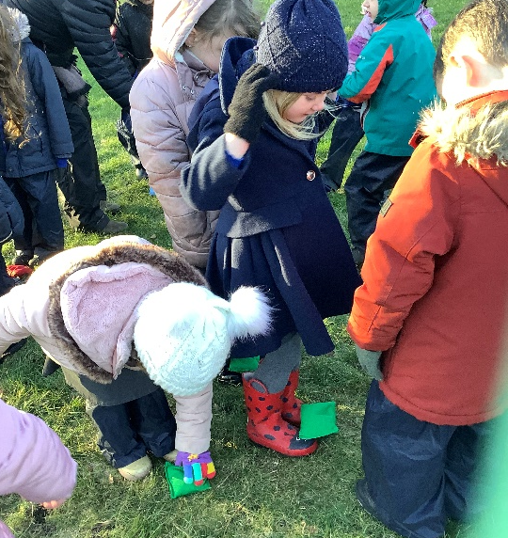
CROMPTON PRIMARY NEWSLETTER
Eco Council
Weekly Tip –
Boil enough water for one cup of tea!
Issue Number 15
12th January 2024
A note from the Headteacher
DATES FOR YOUR DIARY
The Spring Term has begun and it has been a delight to welcome all pupils back this week with tales of what they did over the Christmas Break. Happy New Year to all of our families. 2024 will undoubtedly see a few changes in the way we operate here at Crompton Primary School, to bring the school in line with my vision for the school and the vision of the school governors. The first change will be the way we communicate school events with you. This will be the last weekly newsletter we will be sending you. From this point forward, upcoming events and information you need to know will be forwarded to you by ParentMail. Our Newsletter will now be sent once per half term and will provide a review of activities that have taken place at Crompton. Please ensure that your email address and contact details are up to date with the school office as any announcements or important information or dates will be emailed directly to you.
Mrs Gemma Croston, Headteacher
Spring Term 1
Monday 8 January – Friday 16 February
Spring Term 2
Monday 26 February – Thursday 28 March
Summer Term 1
Monday 15 April – Friday 24 May
Summer Term 2
Monday 3 June – Friday 19 July
Additional Holidays
Thursday 2 May – Polling Day
Friday 3 May – Staff Inset Day
Monday 4 May – Bank Holiday
Autumn Term 2
Monday 30 October – Friday 22 December
FOREST SCHOOL FUN
You may imagine that pupils are reluctant to join our Forest School sessions during the Winter months. However, during last Tuesday’s bitter cold and windy weather not a single Year 2 child complained about the cold, while the Reception children manifested their inner penguins as they played games linked to their new class book Lost and Found.
They huddled together to keep out the cold and shuffled eggs to a ’penguin’ partner’s feet to keep it safe and warm. This was followed by a fun game of ‘tig’ where our little penguins had to safely pass the ‘sealions’ to hunt for food.
We always try to play games to keep the children warm during sessions and we have waterproof pants and coats that they can wear.
What we would suggest during the next half term is that Reception and Year 2 children bring hats, gloves, scarves and boots on Tuesdays.
Crompton Primary School
Longfield Road
Shaw
Oldham
OL2 7HD
Telephone
0161 770 6741
Email
info@crompton.oldham.sch.uk
Website
www.crompton.oldham.sch.uk
Twitter
@cromptonpri
ATTENDANCE AWARDS
We are changing the way that we reward attendance this year. An Attendance Assembly will now take place at the end of the Summer Term, where gold badges will be given to pupils for 100 per cent attendance and bronze and silver for high attendance. Pupils will, however, be given certificates in the classroom termly to reward attendance.

