Slide 1
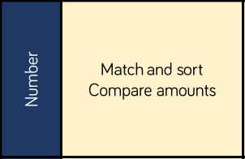
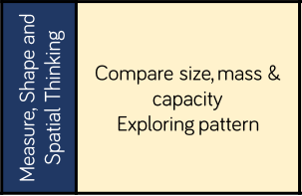
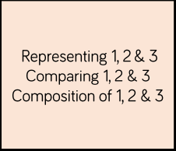
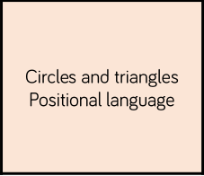
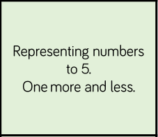
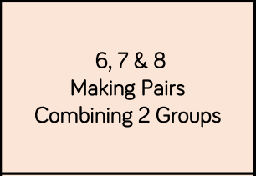
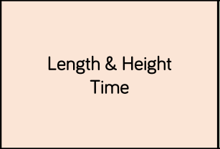
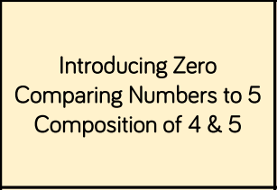
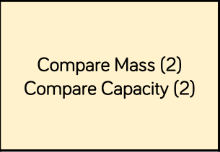
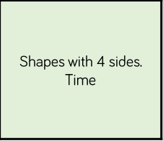
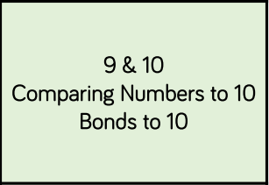
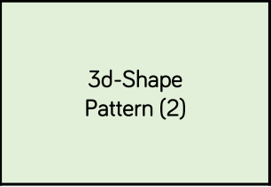
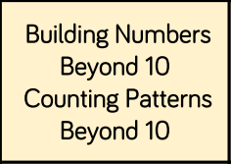
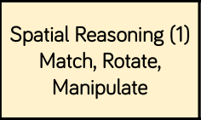
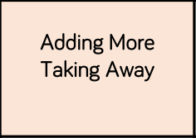
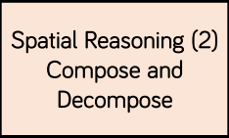
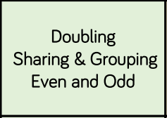
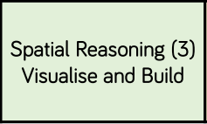
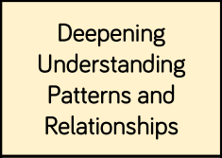
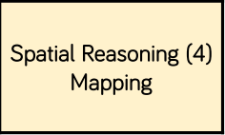
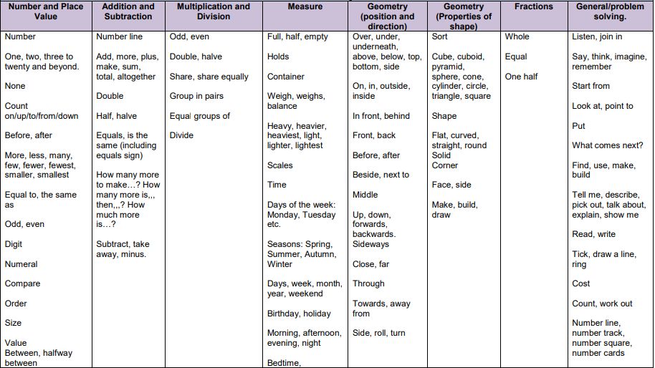
EYFS Maths’ Pathway (WRM)
Getting to know you
Just Like Me
It’s Me 1, 2, 3
Light and Dark
Growing 6, 7, 8
Alive in 5
Building 9 and 10
To 20 and beyond!
First, then, now
Find my pattern
.
.
On the move
.
New vocabulary

Slide 2
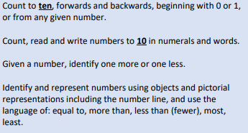
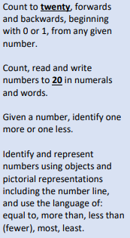
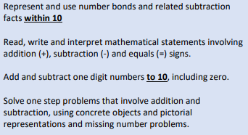
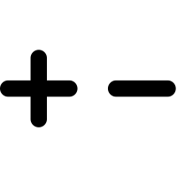
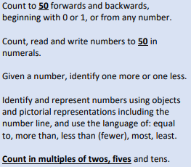
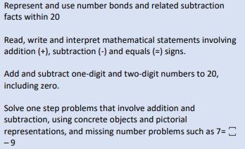
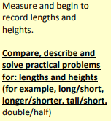
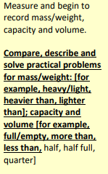
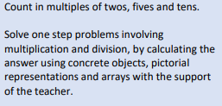
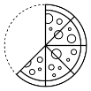
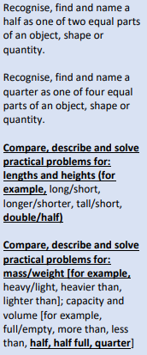
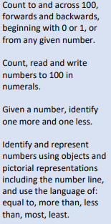
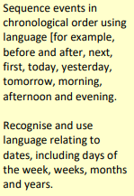
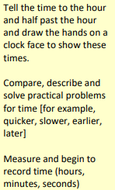
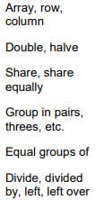
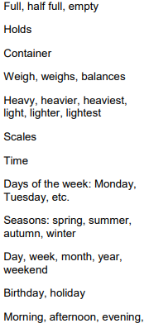
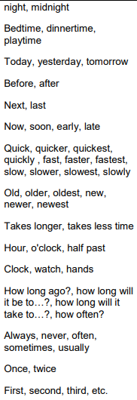
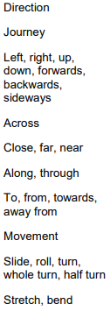
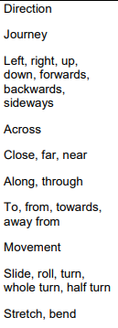
Year 1 Maths’ Pathway (WRM)
Place value (within 10)
Number: Addition and Subtraction (within 10)
Geometry:
Shape
Number: Place value (within 20)
Place value (within 50)
Number: Addition and Subtraction (within 20)
Measurement: Length and Height
Measurement: Weight and Volume
Number: Multiplication and Division
Number: Fractions
.
Place value
(within 100)
.
Geometry: Position and Direction
Measurement: Money
.
Measurement: Time
New vocabulary
GD
EXS
WTS

Slide 3
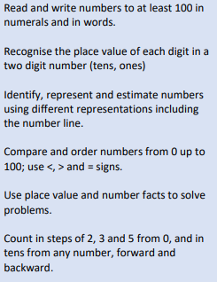
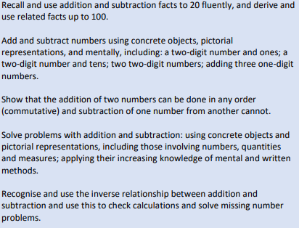
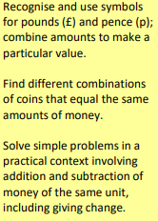
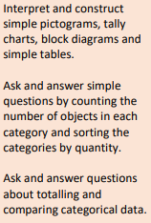
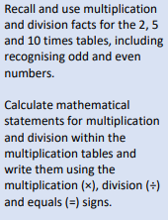
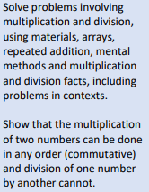
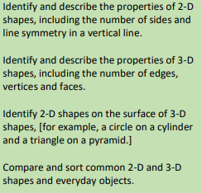
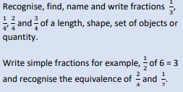
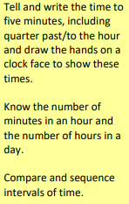
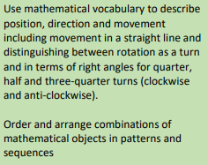
Year 2 Maths’ Pathway (WRM)
Place value
Number: Addition and Subtraction
Measurement:
Money
Number: Multiplication and division
Statistics
Number: Multiplication and division
Geometry: Properties of shapes
Number: Fractions
Measurement:
Length and Height
Geometry: Position and direction
.
Measurement:
Time
.
Problem solving
Measurement: Mass, capacity and temperature
.
New vocabulary
GD
EXS
WTS

Slide 4
Year 3 Maths’ Pathway (WRM)
Place value
Number: Addition and Subtraction
Number: Multiplication and Division
Number: Multiplication and division
Statistics
Measurement: Money
Measurement: Length and Perimeter
Number: Fractions
Number: Fractions
Measurement: Time
.
Measurement:
Mass and Capacity
.
Geometry: Properties of shape
.
New vocabulary
GD
EXS
WTS

Slide 5
Year 4 Maths’ Pathway (WRM)
Place value
Number: Addition and Subtraction
Measurement: Length and Perimeter
Number: Multiplication and division
Measurement: Area
Number: Multiplication and
division
Number: Fractions
Number: Decimals
Number:
Decimals
Measurement: Money
.
Statistics
.
Measurement:
Time
Geometry: Properties of shape
.
Geometry: Position and direction
New vocabulary
GD
EXS
WTS

Slide 6
Year 5 Maths’ Pathway (WRM)
Place value
Number: Addition and Subtraction
Statistics
Number: Multiplication and division
Number: Multiplication
and division
Measurement: Perimeter and area
Number: Fractions
Number: Decimals and percentages
Number:
Decimals
Geometry: Properties of shape
.
.
Geometry: Position and direction
Measuring: Converting units
.
Measurement: Volume
New vocabulary
GD
EXS
WTS

Slide 7
Year 6 Maths’ Pathway (WRM)
Place value
Number: Addition, Subtraction, multiplication and division
Number: Fractions
Geometry: Position and direction
Number: Percentages
Number: Decimals
Number: Algebra
Measurement: Converting units
Measurement: Perimeter, Area and Volume
Number: Ratio
.
Statistics
.
Geometry: Properties of shape
Projects, investigation and transition units
.
New vocabulary
GD
EXS
WTS

Slide 8
Year 1/2 Maths’ Pathway (WRM)
Place value (within 10)
Number: Addition and Subtraction (within 10)
Geometry:
Shape
Number: Place value (within 20)
Place value (within 50)
Number: Addition and Subtraction (within 20)
Measurement: Length and Height
Measurement: Weight and Volume
Number: Multiplication and Division
Number: Fractions
.
Place value
(within 100)
.
Geometry: Position and Direction
Measurement: Money
.
Measurement: Time
New vocabulary
GD
EXS
WTS

Slide 9
Place value
Year 3/4 Maths’ Pathway (WRM)
Number: Addition and Subtraction
Number: Multiplication and Division
Number: Multiplication and division
Statistics
Measurement: Money
Measurement: Length and Perimeter
Number: Fractions
Number: Fractions
Measurement: Time
.
.
Geometry: Properties of shape
Measurement:
Mass and Capacity
.
Geometry: Position and direction
New vocabulary
GD
EXS
WTS

Slide 10
Place value
Year 5/6 Maths’ Pathway (WRM)
Number: Addition, Subtraction, multiplication and division
Statistics
Number: Fractions
Measurement: Perimeter and area and volume
Number: Decimals and percentages
Geometry: Properties of shape
.
.
Geometry: Position and direction
Measuring: Converting units
.
Number: Algebra
Number: Ratio
New vocabulary
GD
EXS
WTS

Slide 11
Place Value Pathway (WRM)
Year 1
Year 2
Year 3
Year 4
Year 5
.
.
.
Year 6
New vocabulary

Slide 12
Addition and Subtraction
Pathway (WRM)
Year 1
Year 2
Year 3
Year 4
Year 5
Year 6
.
.
.
New vocabulary

Slide 13
Multiplication and division
Pathway (WRM)
Year 1
Year 2
Year 3
Year 4
Year 5
.
Year 6
.
.
New vocabulary

Slide 14
Shape
Pathway (WRM)
Year 1
Year 2
Year 3
Year 4
Year 5
.
Year 6
.
.
New vocabulary

Slide 15
Fractions
Pathway (WRM)
Year 1
Year 2
Year 3
Year 4
Year 5
.
Year 6
.
.
New vocabulary

Slide 16
Money
Pathway (WRM)
Year 1
Year 2
Year 3
Year 4
Year 5
.
Year 6
.
.

Slide 17
Position and direction
Pathway (WRM)
Year 1
Year 2
Year 3
Year 4
Year 5
.
Year 6
.
.
New vocabulary

Slide 18
Statistics
Pathway (WRM)
Year 1
Year 2
Year 3
Year 4
Year 5
.
Year 6
.
.
New vocabulary

